Slide 1

retweets
By:
Mor peled
&
Shmoel shuan
Can we find correlations between retweets and the tweets themselves?
How to get retweeted?

Slide 2
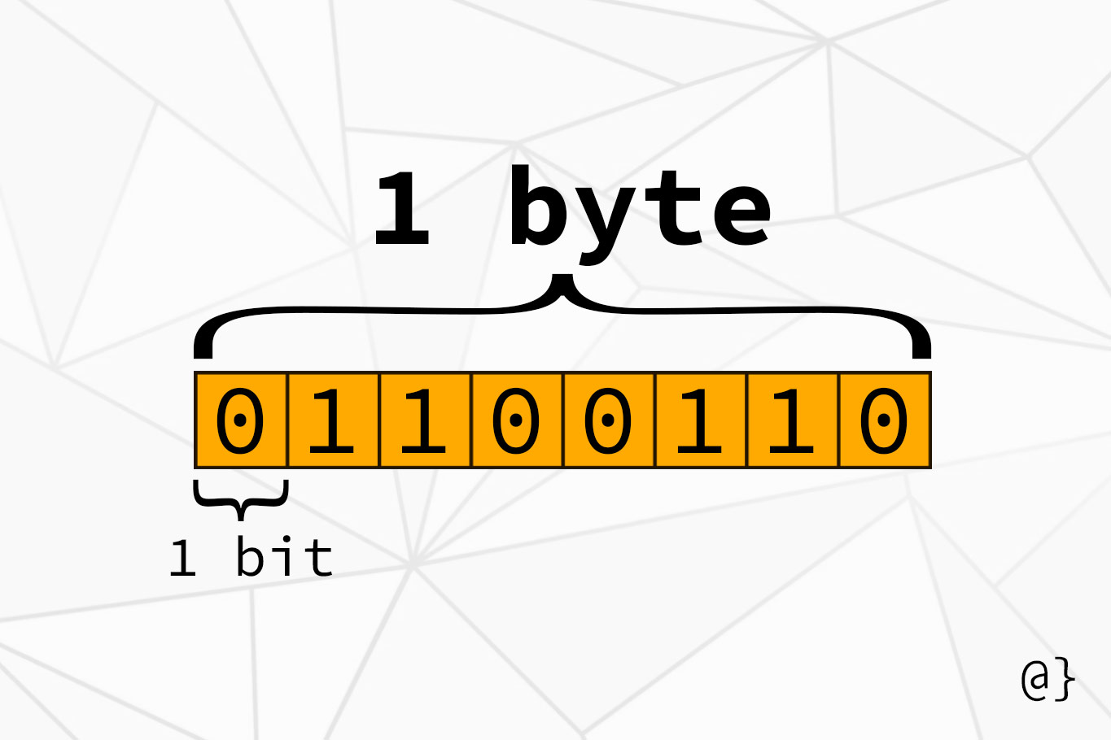
twitter
Twitter is an American microblogging and social networking service on which users post and interact with messages known as "tweets". Registered users can post, like, and retweet tweets, but unregistered users can only read them.
Twitter was created by Jack Dorsey, Noah Glass, Biz Stone, and Evan Williams in March 2006 and launched in July of that year. By 2012, more than 100 million users posted 340 million tweets a day
As of 2019, Twitter had more than 330 million monthly active users.
A bit of background

Slide 3
Initial plans:
A:
Using Twitter`s new API v2 to collect tweets from all the way back to 2006, when Twitter first activated its` servers. It also provides an abundance of built-in functions that would have made data collection easier.
Unfortunately, this required an approved developer's account and Twitter did not approve my request.
B:
Using the API services that are open to all Twitter`s approved users.
Limitations:
It limits me to tweets from the last seven days.
Less tweets per month that we can pull.
And as will be shown, it is not easy to use.

Slide 4
Main process steps of the project
Using twitter`s API for
collecting and
obtaining the
data
Cleaning,
formatting,
and filtering
the data
Visualizing
and
understanding
the data
Clustering the
data into
groups,
modeling and
the algorithm
Presentation
of data,
understanding
and
delivering the
results + Final
predict model

Slide 5
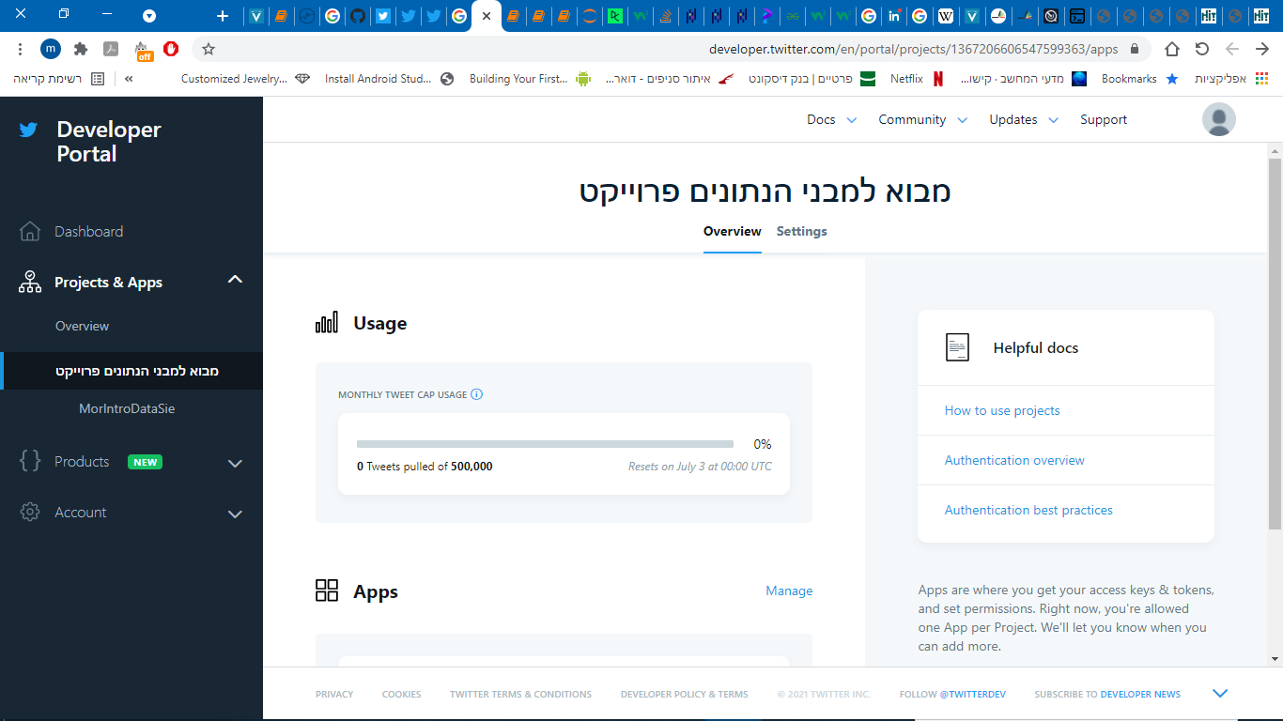
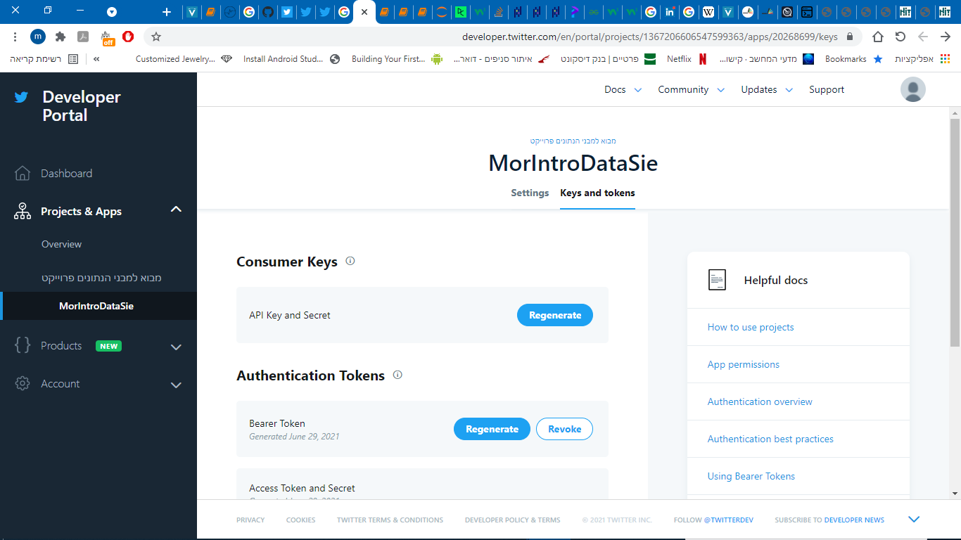
To use Twitter`s API:
First one would have to create an account in twitter.
Second, he would have to create a project in Twitter`s Developer Portal.
And last, one would need to generate several keys and tokens to authenticate requests.
After these steps all of the work is done in Jupiter Notebook.

Slide 6
Tolls
api.retweets(tweetId)
Tweepy also gives the option of getting lists of data about a tweet with the id of said tweet.
Api.retweets is an example; you send an id and get a list of all user's names that retweeted the tweet.
Tweepy. Cursor
The cursor have many search options. I used the (api.search) option to get up to 200 tweets per request.
But there is a problem we anticipate, there are restrictions to the number of requests and number of tweets that can be asked\pulled, so how do we get 10,000 tweets?

Slide 7
how we approached the problem:
We began by getting 100 tweets and building a data-frame with 5 columns: id, username, text, time stamps, and retweets.
Then ran it in a loop by using the max_id that are older than the id of the last tweet (from last batch)
We ran into another problem; the list twitter provides wouldn’t give us more then a 1000 tweets per query
tweets = tw.Cursor(api.search,
q=search_words,
lang="en",
result_type='popular',
max_id=highId,
until = '2021-06-18',
count = 100)
for tweet in tweets.items(int(100)):
count = reTweetCount(tweet.id)
tmpDF = pd.DataFrame({
'id': [tweet.id],
'user name': [tweet.user.screen_name],
'text': [tweet.text],
'time stamps': [tweet.created_at],
'retweets': [count]
})

Slide 8
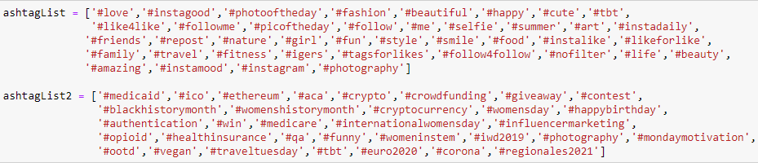
New approach
We asked for 200 tweets from each of the # collected from lists of “# to use to get retweeted”, we were hoping to get viral tweets in the mix.
We built a function to count the number of users that retweeted the tweet, used it on each tweet pulled, but alas we had yet another problem, the highest retweet count is 20, we are not sure why, but the API was giving up to 20 usernames in the lists.
On previous tests we had an occasional 400 retweets so im not sure if it was a malfunction or a new update to the API but we had to count on 20 retweets, to count as 20+, it will limit the questions we can ask and answer but there is no time to run it again. when I tried to run with shorter sleep periods I didn’t get anything. It takes around 45-50 min` to send 100 queries, for all 10,000 tweets it will take 5000 min`, more then 3 days.
I had an idea of using crawling methods to go to the tweet page on twitter and pulling the retweet count from there, but there is no time to implement it, or guaranty that twitter doesn't have safeguards in place. I did it manually for a few tweets to confirm that only the tweets with 20 counted retweets could have more retweets then in my df.

Slide 9
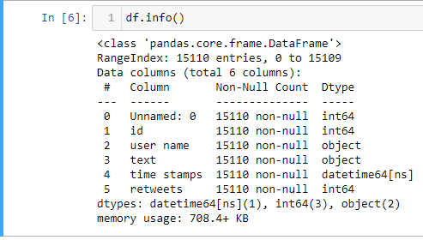
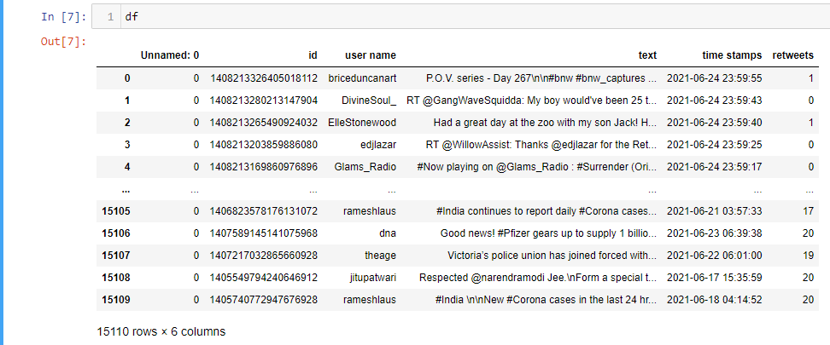
This is the DF before scrubbing.
No missing data, nice.
We will delete duplicates using pandas built in function. There were around 2000.
And we will delete the unnamed column.

Slide 10

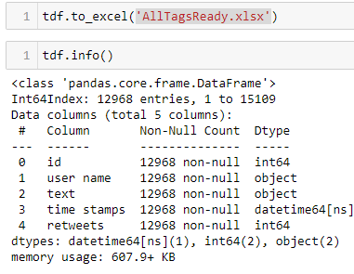
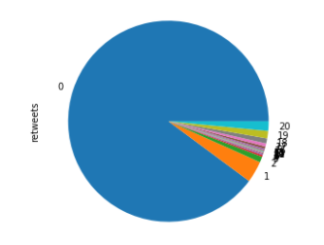
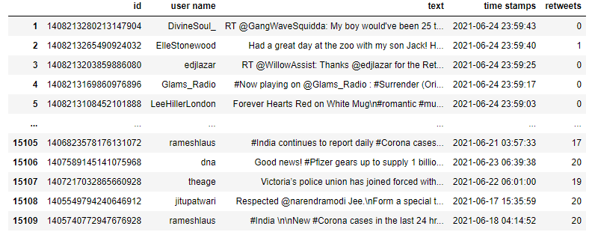
We have 11653 tweets with zero retweets
So P(x=0) when x is number of retweets, is:
11653/12968 = 0.898 = 90%
Therefore P(x!=0): 10%
In other words, for every tweet you post you have a 10% chance of getting retweeted at least once.
When the chances are so low, maybe we can turn to machine learning to make predictions for us.

Slide 11
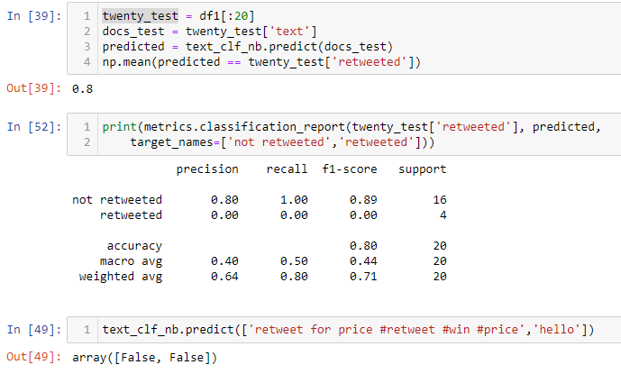
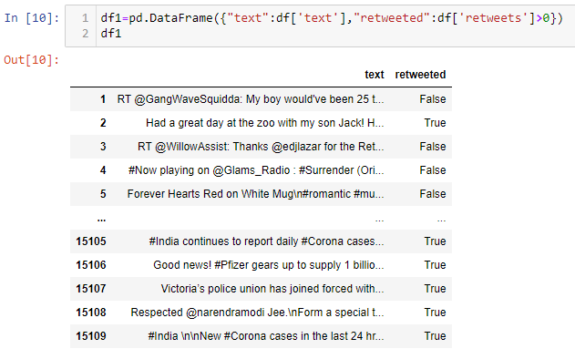
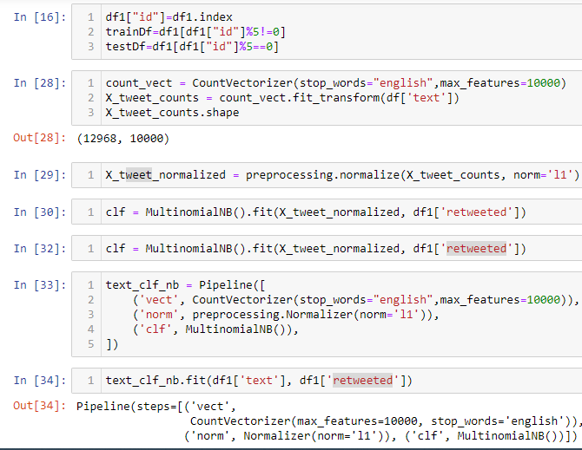
Immediately I tried to use functions we learned in class, to build a prediction using MultinomialNB.
We had an accuracy of 80%
But looking closely the machine only guessed that we won't get retweeted. And we already know we have 90% if we look at all the tweets, the cut had more retweets then average.
On to the next idea.

Slide 12
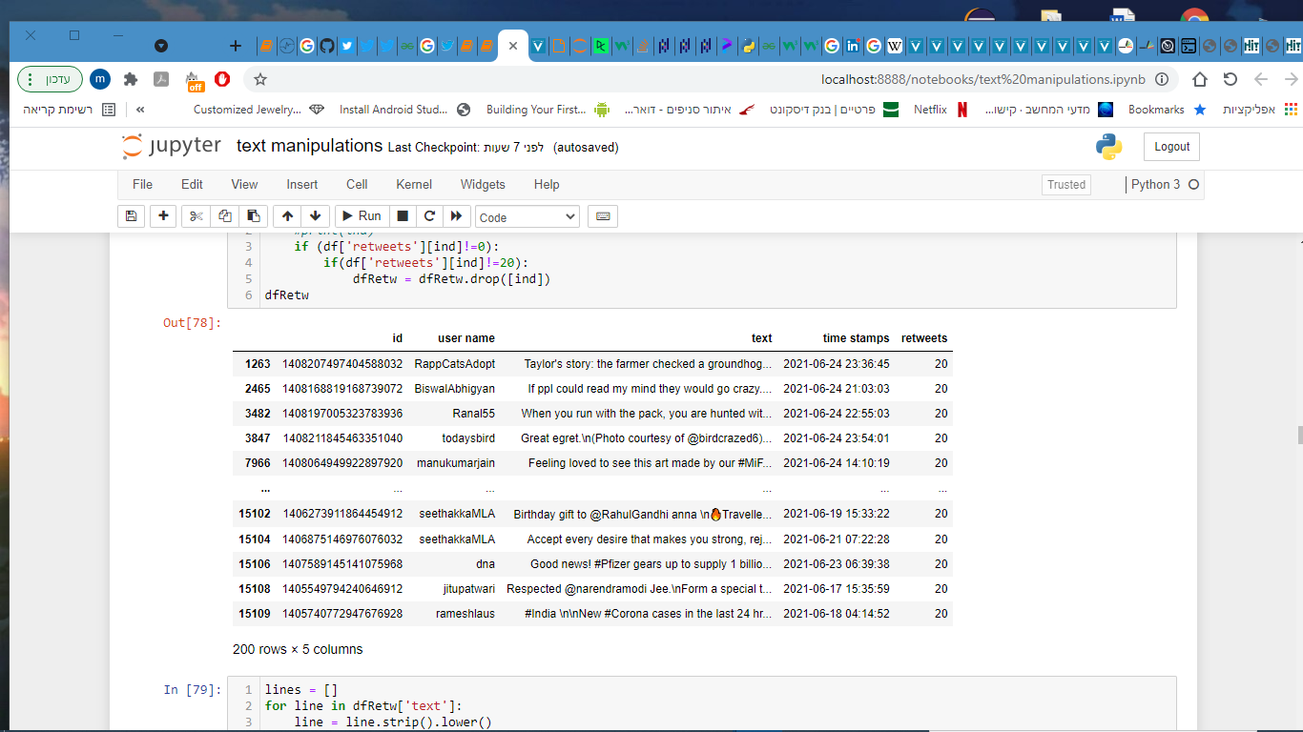
We made three data frames and made graphs to each.
In here we see the smallest df containing only tweets with 20 plus retweets.
The other two are: all the tweets, and all the retweeted tweets.

Slide 13
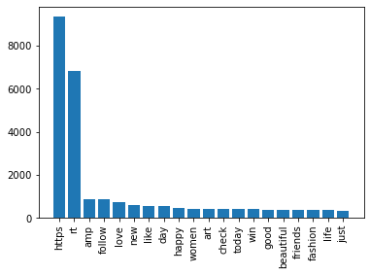
20 most used words in all the tweets

Slide 14
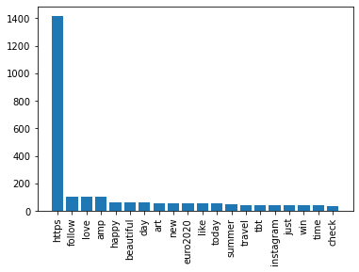
20 most used words only in the tweets that were retweeted

Slide 15
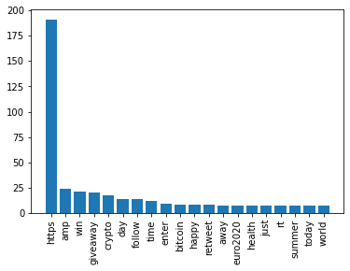
20 most used words only 20+ retweets

Slide 16
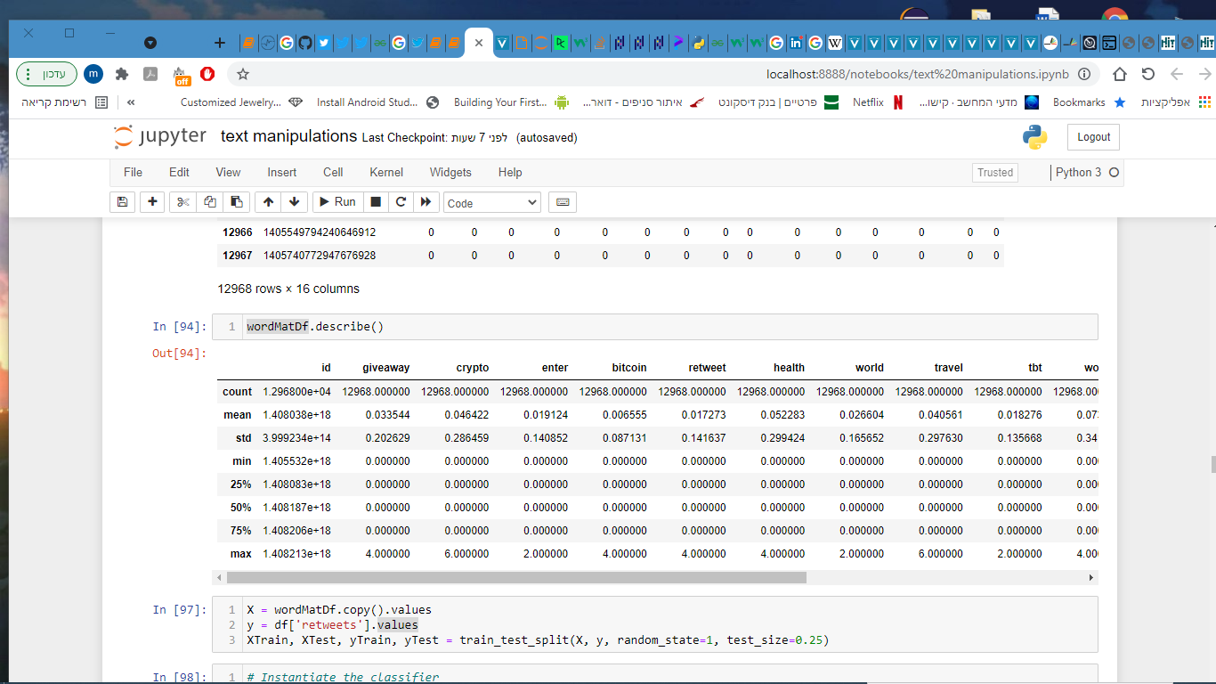
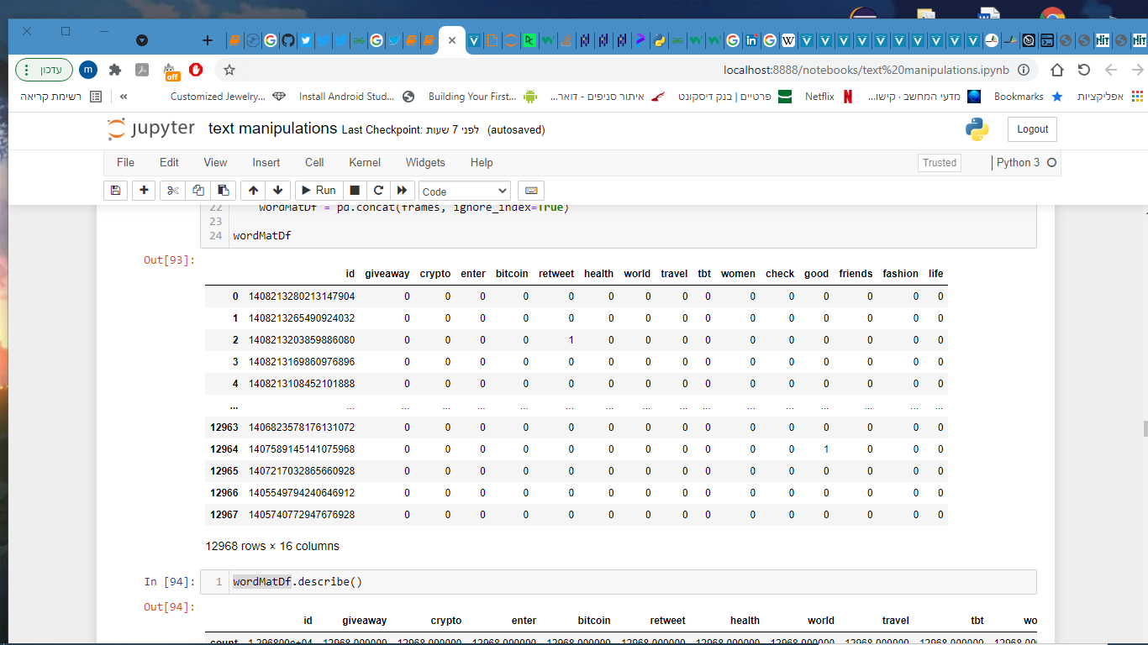
We made a df to define X
And y is defined by: df[‘retweets’]>0.
Now all that is left is to make the machine.

Slide 17
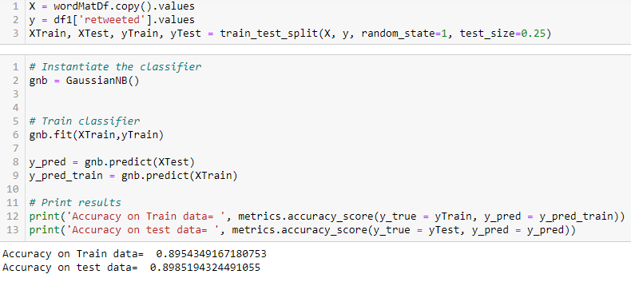
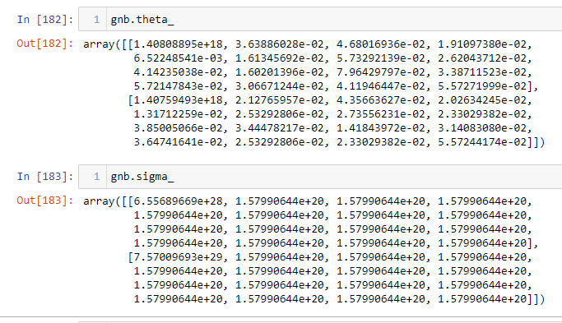
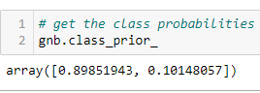
Using gaussianNB() we have almost 90% accuracy in training and test.
We know there is no dependency between how many times one word appear in a tweet then another word.
So we have no problem using Naïve Bayes.
Theta and Sigma are shown.

Slide 18
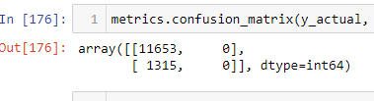
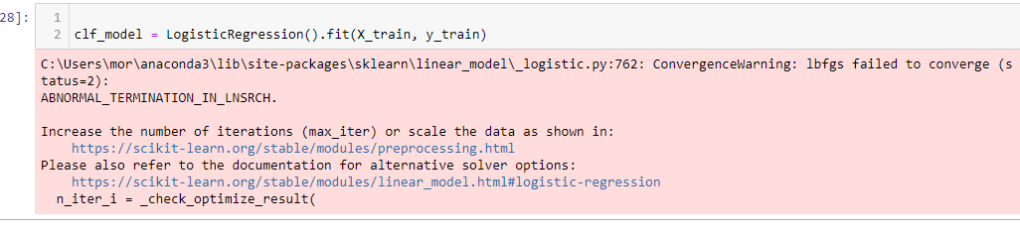
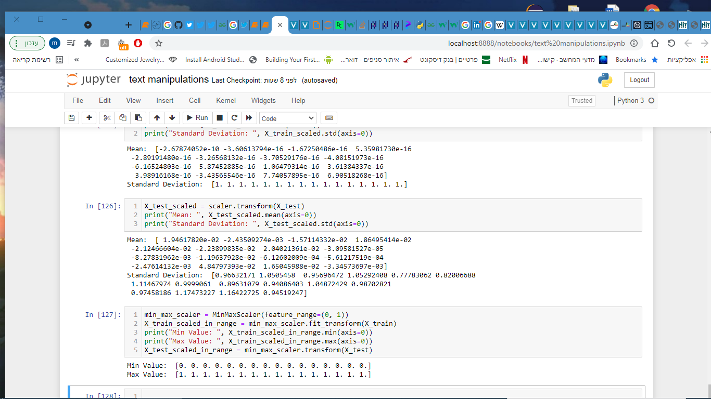
We kept trying
But came to similar problems as before where the machine only guesses zero retweets.
Or a processing problem we couldn’t resolve .

Slide 19
summery
We asked the Q`, can we predict if a given tweet will get retweeted?
To get our data we used twitter`s API to get tweets and number of retweets.
We analyzed the texts of the tweets, only 10% of the tweets get retweeted. We produced 15 words to put in a vector matrix, that was X. we made a new df to represent y by changing any retweets bigger then zero to one.
We used Naïve Bayes to build a machine, It doesn't only guess zero retweets and still has accuracy close to 90%.
now we can try ang apply it on our twitter and see if it works ☺

Slide 20
Thank you
For listening

